Slide 1
IASA-TC 06
Video Preservation Guidelines https://www.iasa-web.org/tc06/guidelines-preservation-video-recordings
Overview of the First Edition
Carl Fleischhauer and Lars Gaustad
IASA Technical Committee
NoTimeToWait3
BFI Southbank, London, October 25th 2018

Slide 2
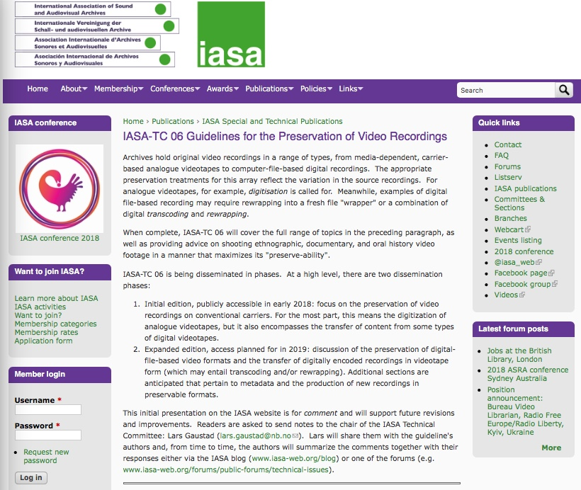
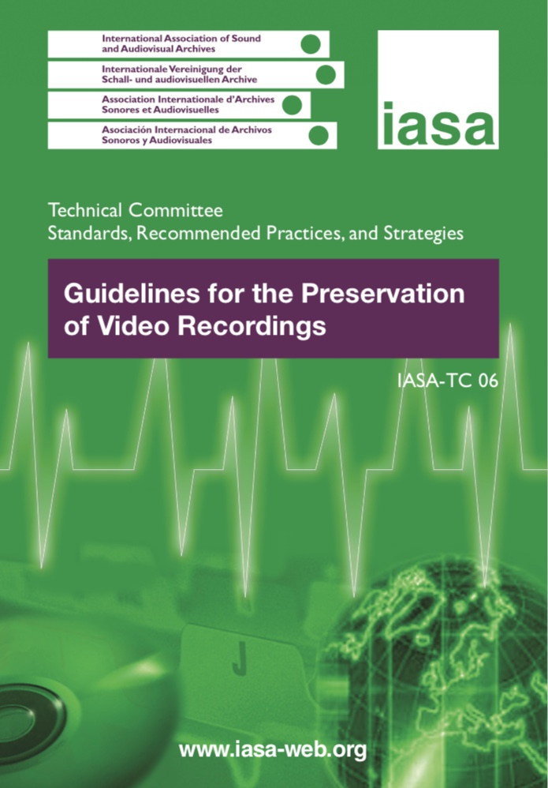
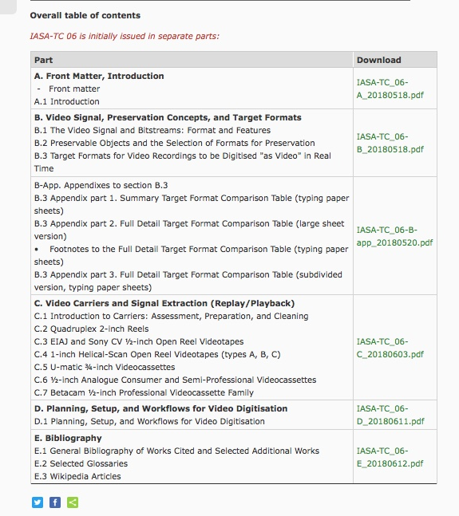
https://www.iasa-web.org/tc06/guidelines-preservation-video-recordings
Notes:
On June 12, 2018, the IASA Technical Committee published the first edition of Guidelines for the Preservation of Video Recordings, IASA-TC 06.

Slide 3
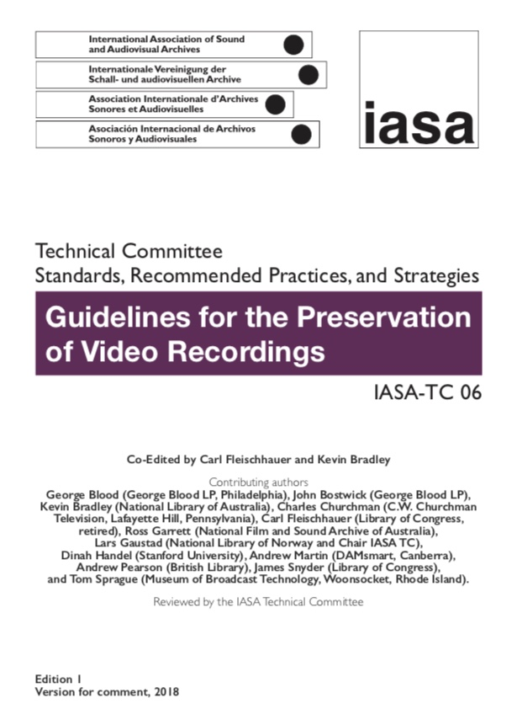
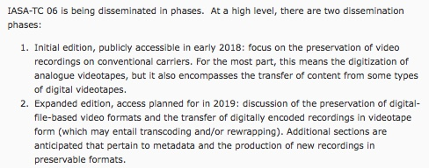
IASA-TC 06 to be published in phases
First edition
Focus on carrier-based recordings, i.e., videotapes (mostly analogue)
First version
Online only as set of PDF files, second version will also be in print
Notes:
The guideline is being published in phases. This first edition focuses on carrier-based recordings, i.e., videotapes (mostly analogue), with additional historical and contextualizing information. After we get advice from readers, we will publish a revised version.

Slide 4
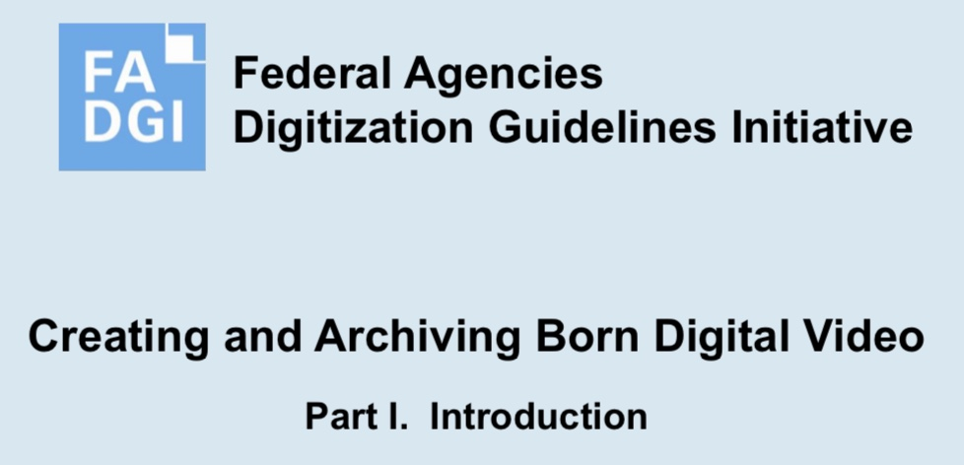
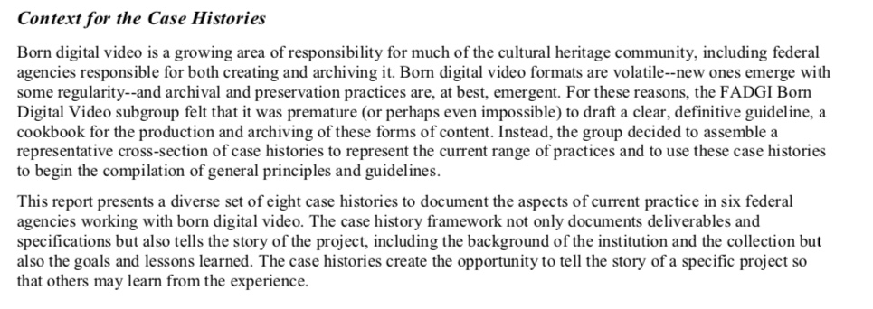
What about file-based born-digital video? The second edition of IASA-TC 06, coming in the future, will treat born digital video. For the moment, here is one useful source of information about file-based digital video:
http://www.digitisationguidelines.gov/guidelines/video_bornDigital.html
There are others as well.
Notes:
Meanwhile, the Technical Committee recognizes that archives are acquiring file-based video recordings and that preservation is an ever-growing problem, and a second edition of TC 06 will come in the future. In the meantime, some information on born digital video is available in other publications, like this one from the US government FADGI group.

Slide 5
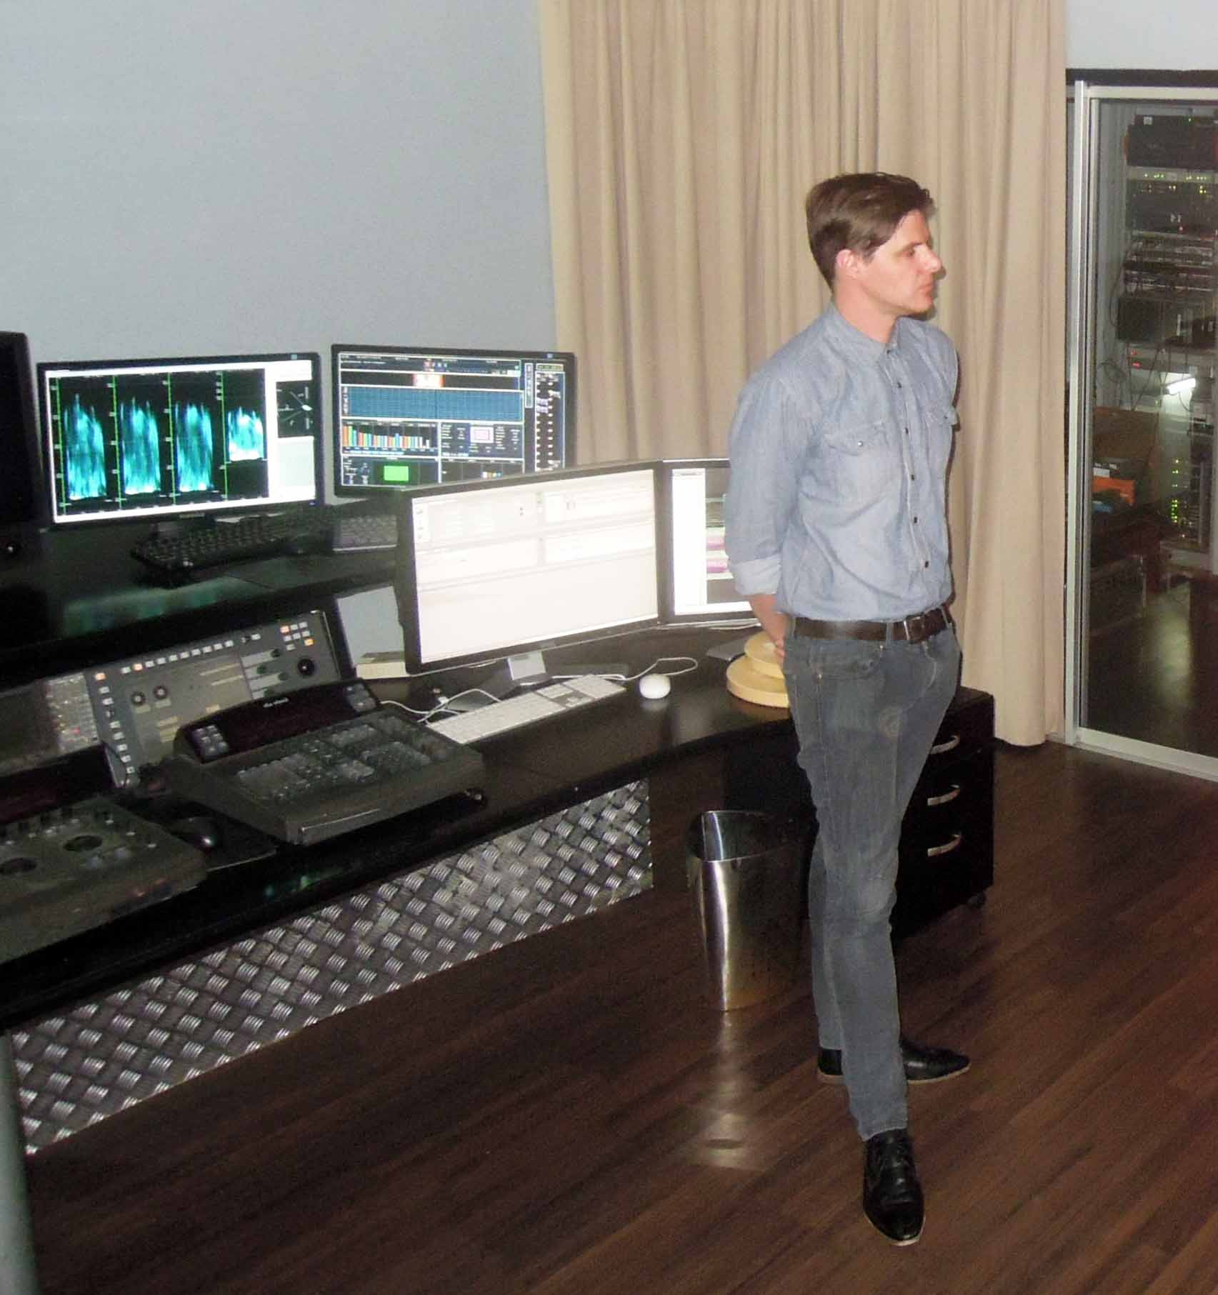
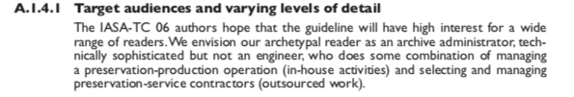
Notes:
The intended audience for the IASA guideline is someone like an archive administrator, technically sophisticated but not an engineer, someone who manages an in-house operation or who selects and manages external contractors.

Slide 6
IASA-TC 06, first edition
Part A. Introduction
Part B. Video Signal, Preservation Concepts, & Target Formats
Part C. Video Carriers and Signal Extraction
Part D. Planning, Setup, & Workflows for Video Digitisation
Part E. Bibliography
Notes:
The first edition begins with an introduction and ends with a bibliography.

Slide 7
IASA-TC 06, first edition
Part A. Introduction
Part B. Video Signal, Preservation Concepts, & Target Formats
Part C. Video Carriers and Signal Extraction
Part D. Planning, Setup, & Workflows for Video Digitisation
Part E. Bibliography
Notes:
Parts B, C, and D contain the most substantive information.
Part B answers the question "what is video" and discusses digital preservation target formats.
Part C discusses carriers -- specifically, six videotape "format families."
Part D concerns planning and setting up a digitisation facility, with a look at selected aspects of production workflows.

Slide 8
Part B. Video Signal, Preservation Concepts, and Target Formats
B.1 The Video Signal and Bitstreams: Format and Features
B.2 Preservable Objects and the Selection of Formats for Preservation
B.3 Target Formats for Video Recordings to be Digitised "as Video" in Real Time
Notes:
One of the three sections in part B provides an overview of the complexities of the video signal. In contrast to the relatively simple types of audio signals discussed in IASA-TC 04, the video signal is far more complex.

Slide 9
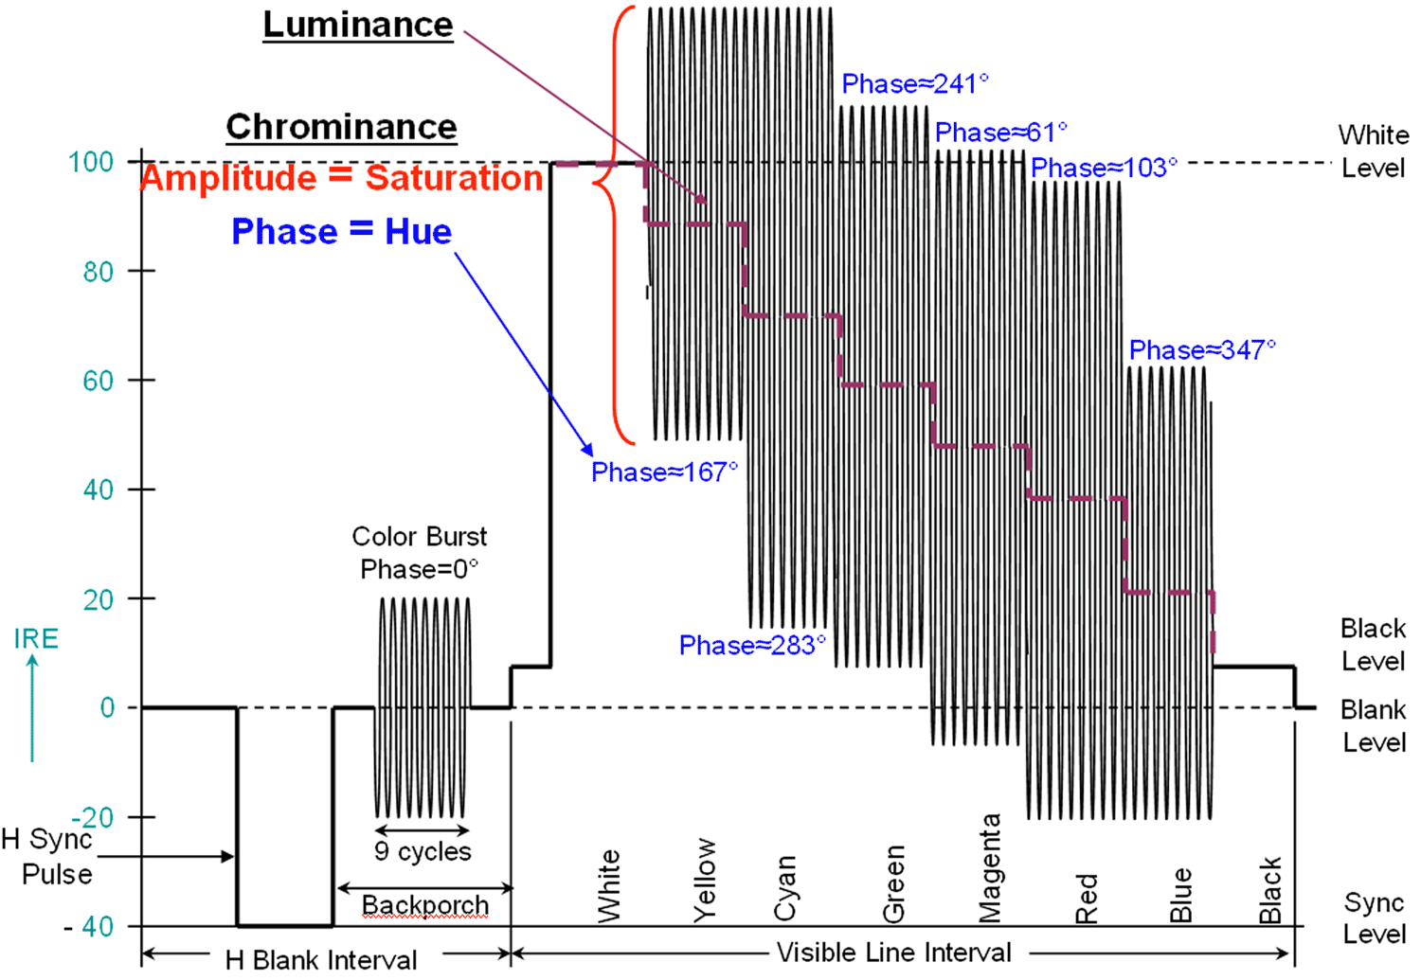
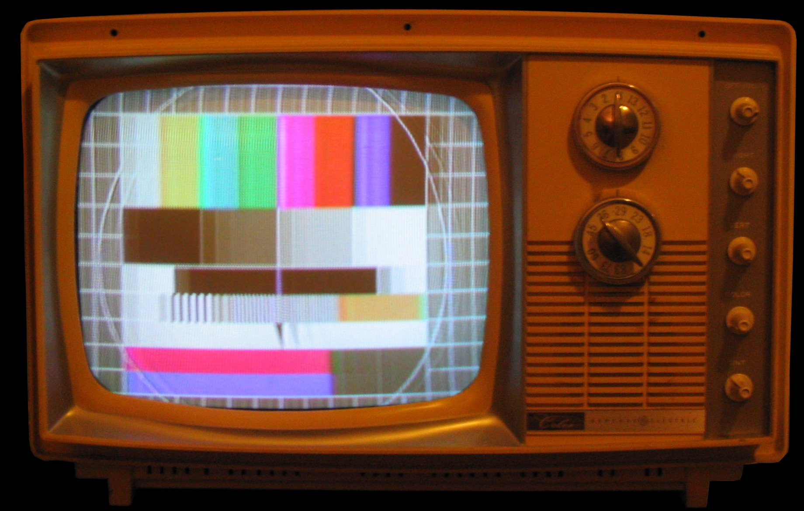
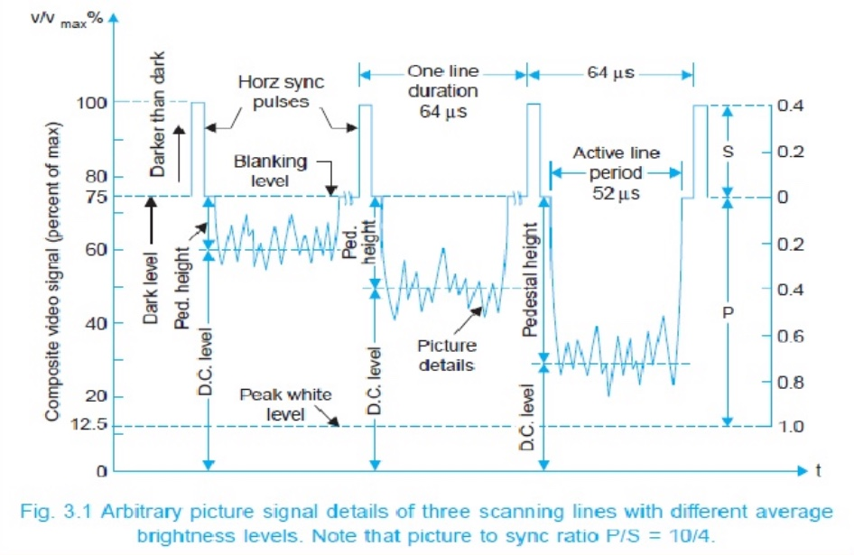
Notes:
Here's an example: in order to get a picture to appear on a television screen, the video signal must include special coding that instructs the playback system on how to synchronize the picture elements: lines, fields, frames, and colour data.

Slide 10
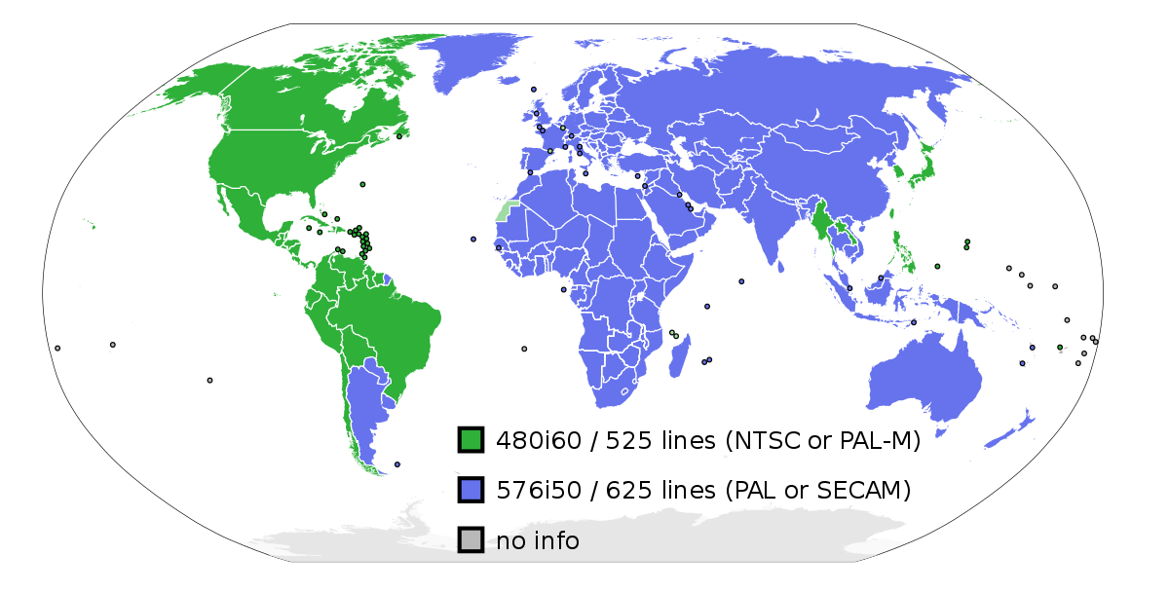
Notes:
As if that was not complicated enough, it is also the case that the details of picture-element synchronization -- and other aspects of video technology -- differ in different parts of the world.

Slide 11
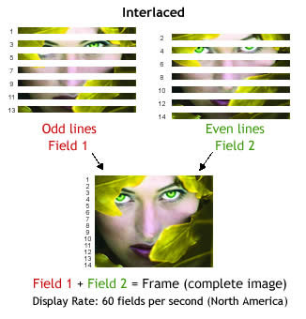
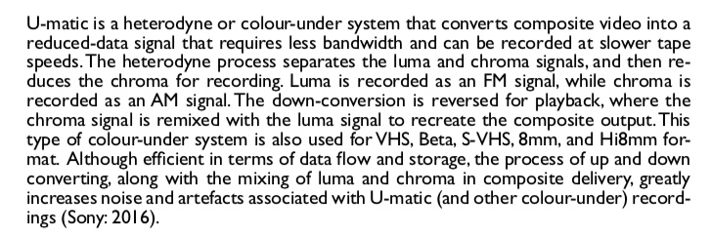
Interlacing
Colour-under
text paragraph from TC 06 section on U-matic tapes
Notes:
Another example of complexity: in order to squeeze picture data into the bandwidth for broadcast transmission and tape recording, a number of engineering "tricks" were applied. These include such things as interlacing and, for certain videotapes, what is called "colour under" recording.

Slide 12
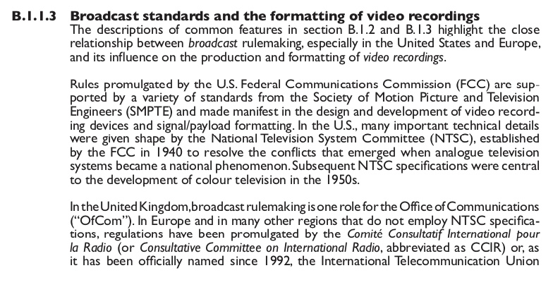
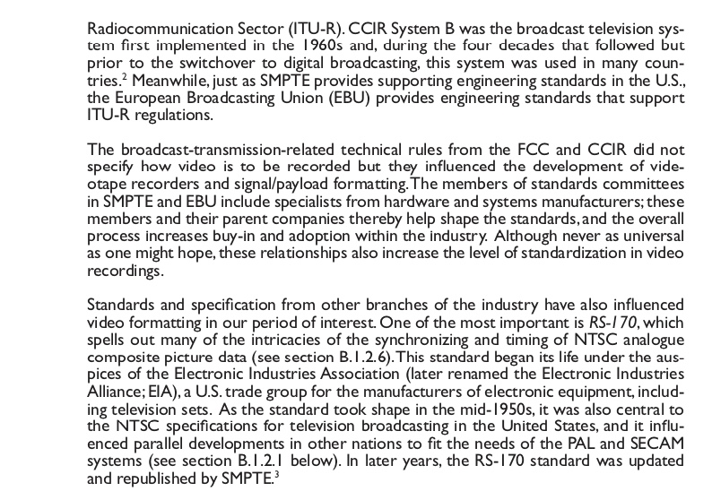
Broadcast specifications, rules, and related standards are (or have been) set by the following bodies (and there are more!)
UNITED STATES (and elsewhere)
FCC
SMPTE
NTSC
EIA
ATSC (digital TV)
UNITED KINGDOM
OfCom
EUROPE (and elsewhere)
ITU-R (former CCIR)
EBU
Notes:
Video technology took shape as television broadcasting got rolling after the Second World War. There was back and forth between broadcast rulemaking and video engineering standardization. These rules and standards have profoundly influenced the shape of video technology during the past 50 years.

Slide 13
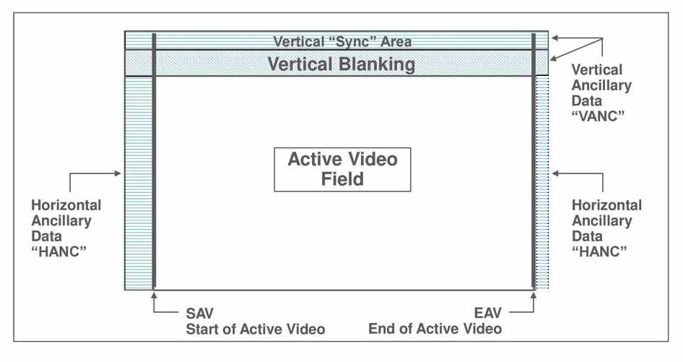
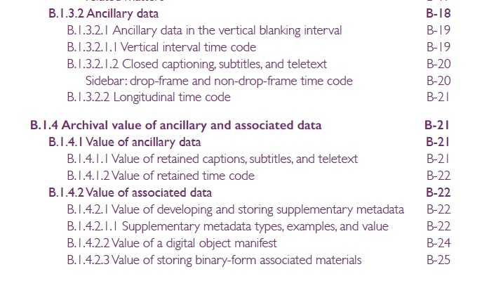
Notes:
To serve broadcasters, video payload components were added, beyond picture and sound --

Slide 14
. . . . and such components as
Multichannel Television Sound (MTS)
Descriptive Video Service (DVS).
Notes:
-- these include timecode (more than one type), captions, and subtitles, as well as multichannel audio, descriptive video services, and other ancillary data. Here again the rulemaking and standardization varied from one part of the world to another.

Slide 15
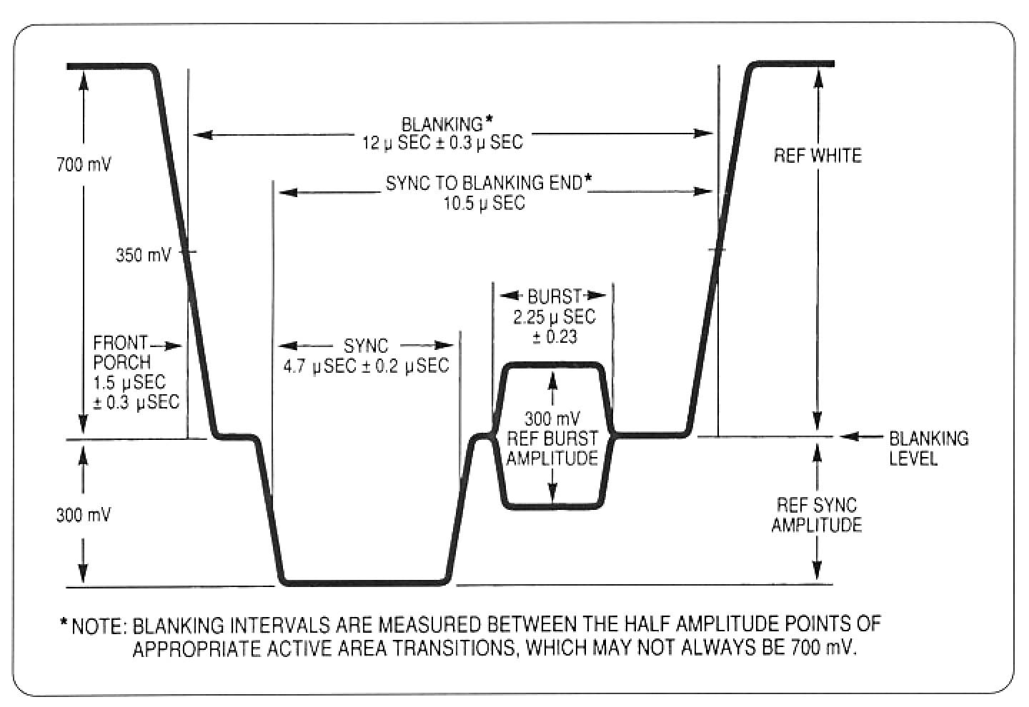
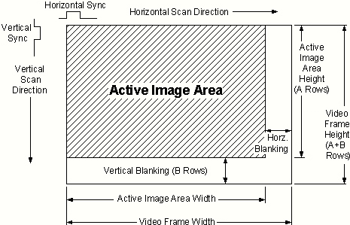
Notes:
The potential complexity of a video recording makes preservation copying more challenging, especially if we seek to produce complete and authentic copies that capture the full payload.

Slide 16
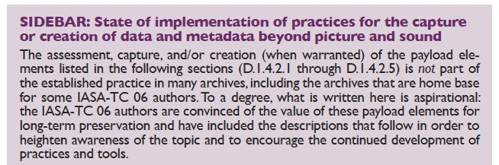
Notes:
The TC 06 authors believe that archivists have not done a thorough job of analyzing the issues associated with full payload. Most discussion is limited to picture and sound. And discussion is not all that is lacking: more needs to be done to develop methods to capture and retain the full payload.

Slide 17
Part B. Video Signal, Preservation Concepts, and Target Formats
B.1 The Video Signal and Bitstreams: Format and Features
B.2 Preservable Objects and the Selection of Formats for Preservation
B.3 Target Formats for Video Recordings to be digitised "as Video" in Real Time
Notes:
The final segment of part B covers digital target formats. A target format is the digital entity that receives and carries the digitised content from a source video recording. It is often a single file but sometimes it might be a bundle of files.

Slide 18
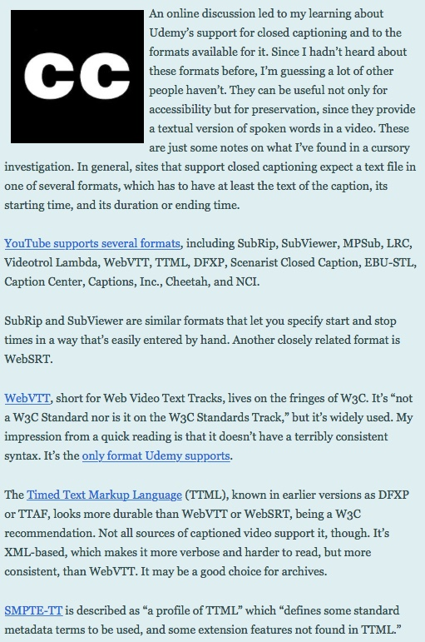
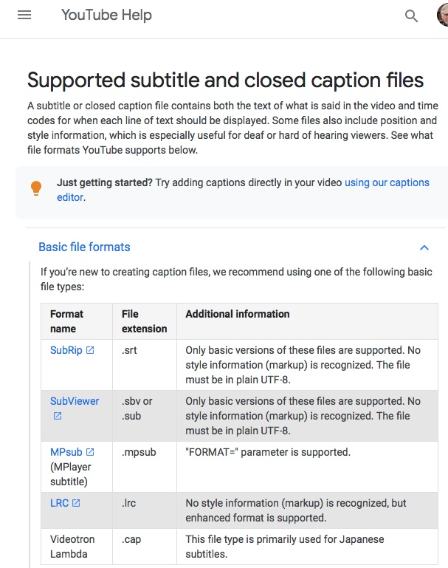
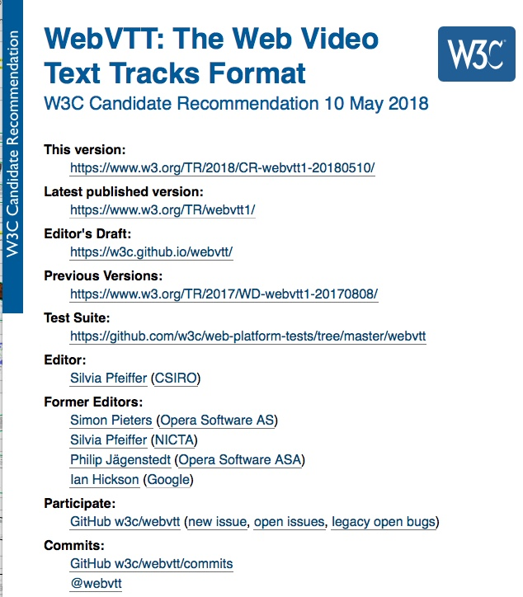
https://madfileformatscience.garymcgath.com/2016/03/16/ | https://www.w3.org/TR/webvtt1/ | https://support.google.com/youtube/answer/2734698
Notes:
For example, "sidecar" files are sometimes used to carry payload components like captions or subtitles. Such files are widely used: here’s a list from the Web, a pointer to a W3C standard, and guidance for those who upload YouTube videos.

Slide 19
Formatting Elements
File wrapper
Encodings
Metadata
Notes:
Meanwhile -- regarding the target format -- don’t forget that we need to consider the file wrapper, the encodings, and metadata.

Slide 20
Formatting Elements
Wrappers
  Often indicated by file extensions
  Generally identified by Internet MediaType (aka MIME type)
  Examples
    Audio Video Interleaved, .avi, video/avi
    Matroska, .mkv, video/x-matroska
    MXF, .mxf, application/mxf
    QuickTime, .mov, video/quicktime
Notes:
Wrappers are identified in a number of ways, including by filename extension or by MIME type.

Slide 21
Formatting Elements
Encodings
  Encoded data represents the essences, e.g., picture and sound
  Picture encodings highlighted in IASA-TC 06
    Uncompressed picture
      Color-difference component (YCbCr), 10-bits, 4:2:2 chroma subsampling, stored as V210
    Lossless compressed picture
      FFV1
      JPEG 2000 (lossless)
Notes:
When we speak of encodings, we generally mean digital data that represents the picture and sound in the file. When digitising videotapes, for example, TC 06 strongly recommends producing picture data encoded in uncompressed or losslessly compressed form.

Slide 22
Formatting Elements
Metadata
  Tech info needed by the player app
  Plus –
    Administrative, e.g., identifier (and more)
    Descriptive, e.g., program title (and more)
    Other supplementary, e.g., digitisation-process information (and more)
  Store in file wrapper and/or database
Notes:
Some metadata must be in the file wrapper: applications need some technical information in order to play the recording. But when you digitise, you should also work to capture additional valuable metadata: administrative, descriptive, and more. Archives sometimes store this supplementary data in the file wrapper, sometimes in a database, sometimes both.

Slide 23
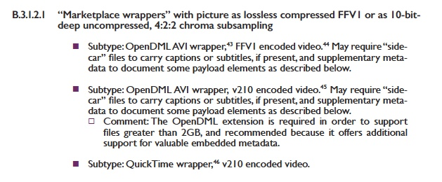
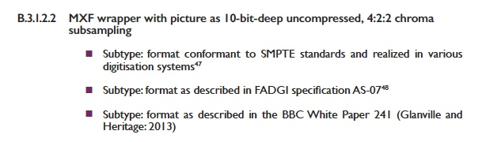
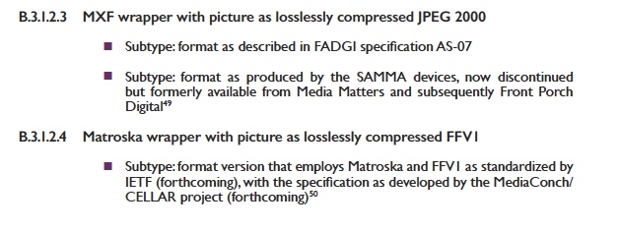
Notes:
What are the target-format options for preservation digitising? TC 06 lists three format families, each of which has its advocates - -

Slide 24
Notes:
First: files that employ the old stand-by wrappers: AVI and QuickTime, capable of carrying a variety of encodings including lossless FFV1.

Slide 25
Notes:
Second, files that use the MXF wrapper, either with uncompressed picture or with lossless JPEG 2000.

Slide 26
Notes:
And third, the Matroska wrapper with lossless FFV1 picture.

Slide 27
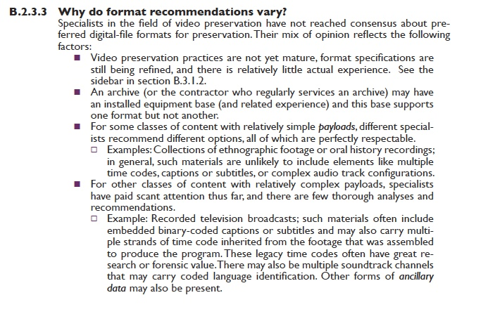
Notes:
Why multiple options?
First, specialists in the field have not reached consensus about what to recommend.
Second, an archive or contractor may have an installed equipment base that supports one format but not another.
Third, some relatively simple-payload original recordings – no captions, no more than one time code, only mono or stereo audio – can be stored effectively by all options. But if your archive holds more complex recordings – with captions, with more than one time code, and so on – you need more support from your target format.

Slide 28
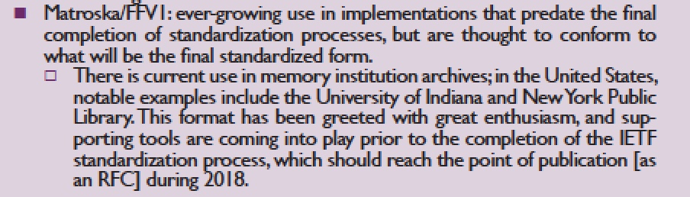
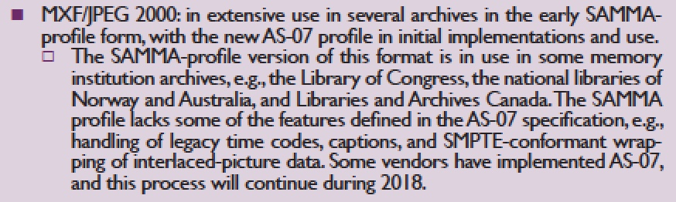
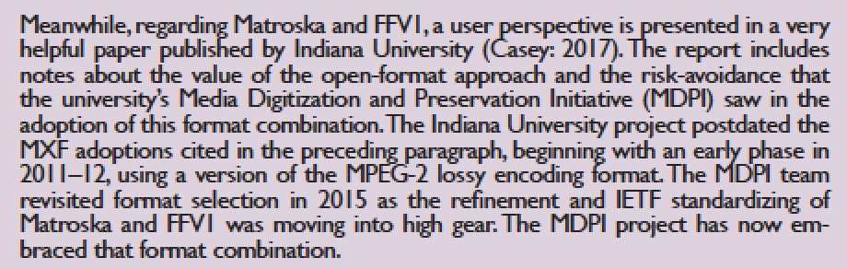
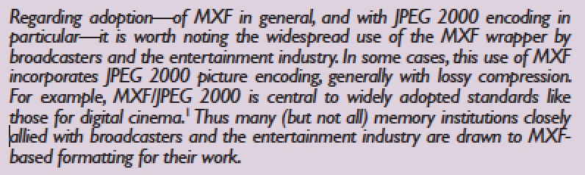
Implementation notes: Matroska/FFV1 and MXF/JPEG2000
Excerpts from TC 06 section B.3
Notes:
There are also multiple communities that gravitate to one format or another.
For example, the Matroska/FFV1 format has been greeted with great enthusiasm, and supporting tools are coming into play even before to the completion of the standardization process. In the United States, for example, this format has been adopted by Indiana University, New York Public Library, and several others.
Meanwhile, the early SAMMA-profile of MXF/JPEG 2000 has been in extensive use at the Library of Congress, the national libraries of Norway and Australia, and Libraries and Archives Canada. Since the MXF wrapper is in widespread use by broadcasters and the entertainment industry, this has attracted some archives, putting their formatting in sync with applications like digital cinema, which uses both MXF and JPEG 2000.
During the next few years, we all look forward to hearing from adopters of Matroska/FFV1 and MXF. Our collective experience will improve our understanding of each format's pluses and minuses.

Slide 29
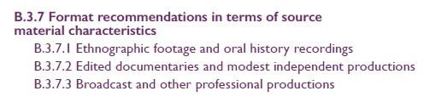
Illustrative examples
Notes:
TC 06 illustrates the point with three illustrative examples with varying levels of payload complexity:
- ethnographic footage
- edited documentaries
- and professional broadcast productions.

Slide 30
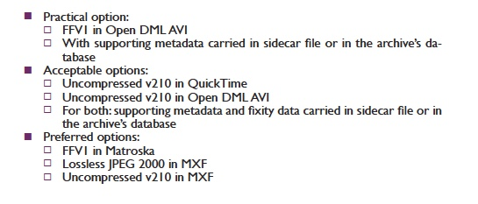
Illustrative examples
Notes:
The box on the right is for ethnographic footage and it shows how TC 06 sketches in the target format options.
The preferred options at the bottom are Matroska and FFV1, or MXF with either JPEG 2000 or uncompressed picture.

Slide 31
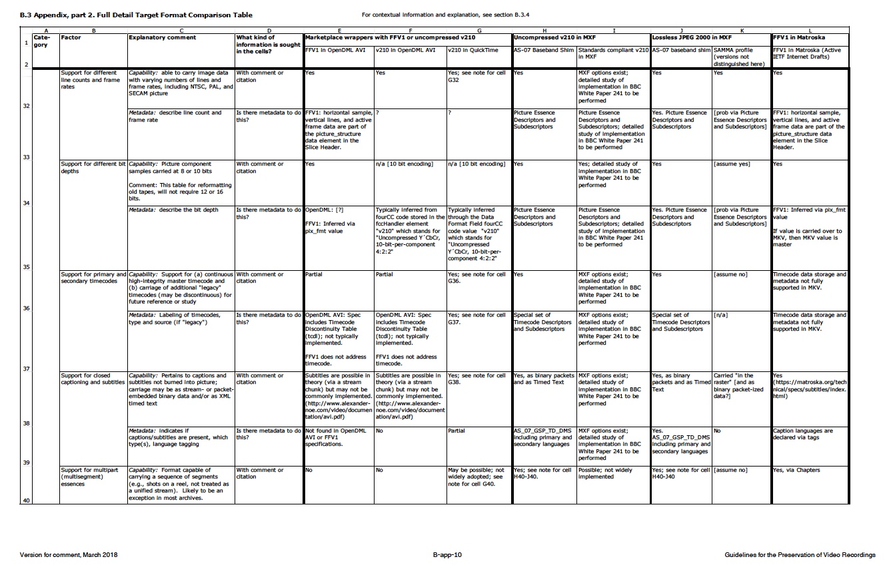
Notes:
For the dedicated, the formats are compared in detailed in an appendix: this is one page of eight.

Slide 32
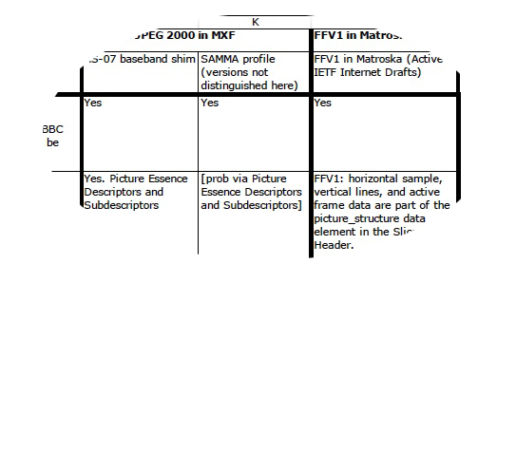
Notes:
Here's one isolated example: good detail on how formats carry metadata that declares how many lines are in the picture, the frame rate, and bit depth.

Slide 33
Part C. Video Carriers and Signal Extraction
Quadruplex 2-inch Reels
EIAJ and Sony CV ½-inch Open Reel Videotapes
1-inch Helical-Scan Open Reel Videotapes (types A, B, C)
U-matic ¾-inch Videocassettes
½-inch Analogue Consumer and Semi-Professional Videocassettes
Betacam ½-inch Professional Videocassette Family
Notes:
Part C of the guideline covers the most common set of videotape formats in archives
Most sections cover a "format family," in which several related or similar types of videotapes are grouped together.

Slide 34
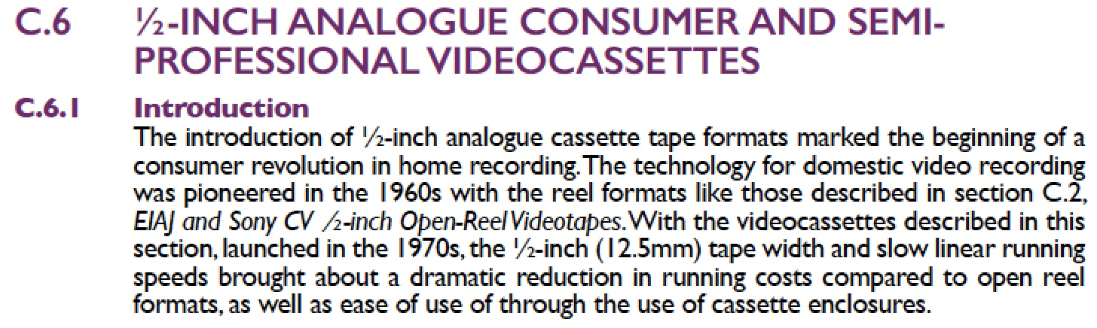
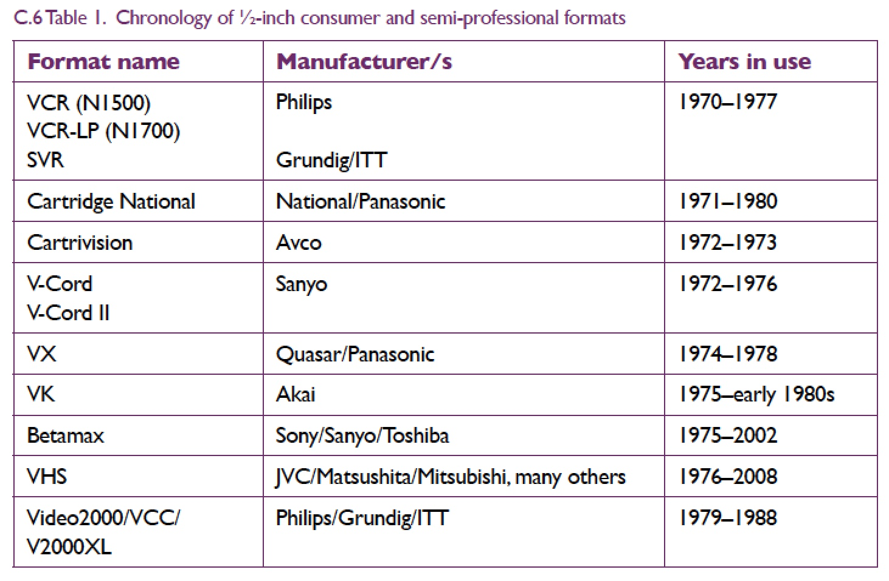
Notes:
For example, the section on ½-inch Analogue Consumer and Semi-Professional Videocassettes -- written by Andrew Pearson from British Library -- covers the many "family members" listed on this slide, which also provides the dates in which the types were produced.

Slide 35
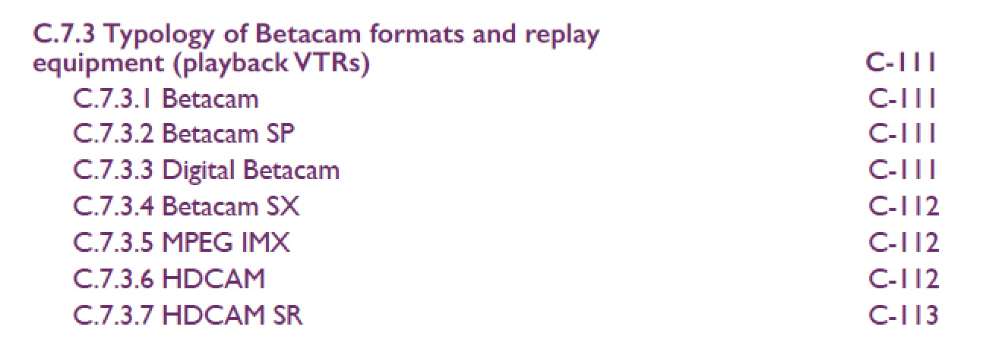
Notes:
As another example, the Betacam section describes the multiple types on this slide. There were also multiple contributors to this section, but the central figure is Ross Garrett of Australia's National Film and Sound Archive.

Slide 36
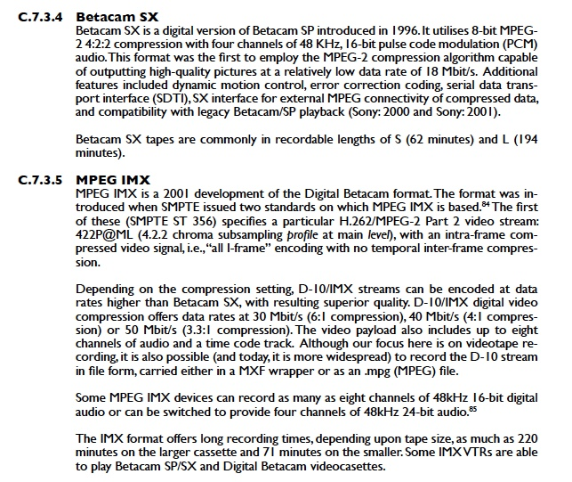
Notes:
Each type gets a write-up: here are the introductory paragraphs for two rather different digital tapes in the Beta family: SX and IMX.

Slide 37
Typical subsections for section C
Intro and history
Selection of best copy
Typology of tapes and VTRs
Compatibility and availability of VTRs
Tape coating formulations
Maintenance and alignment of VTRs
Sound tracks
Time code
Time base correction and dropout compensation
How much time to prep and digitise each tape?
Notes:
Each section devoted to a videotape-format family includes information that (more or less) follows the pattern shown on this slide. Here, TC 06 tries to serve more than our target reader -- the archive administrator – by providing rich detail for practitioners, at a “near-engineering” level.

Slide 38
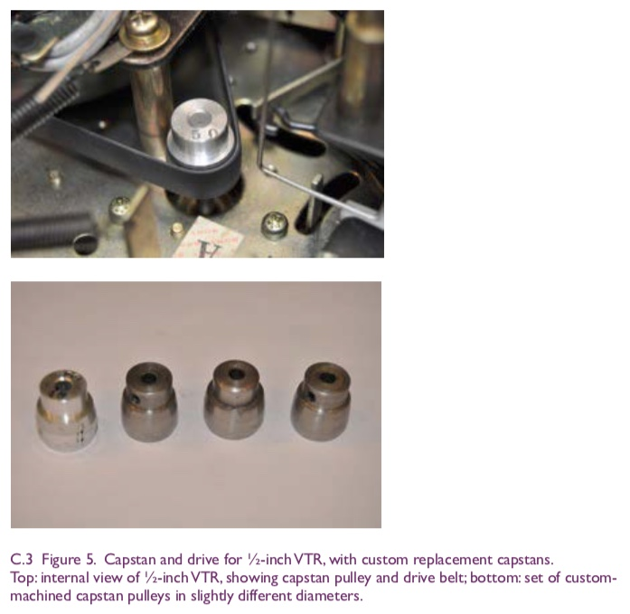
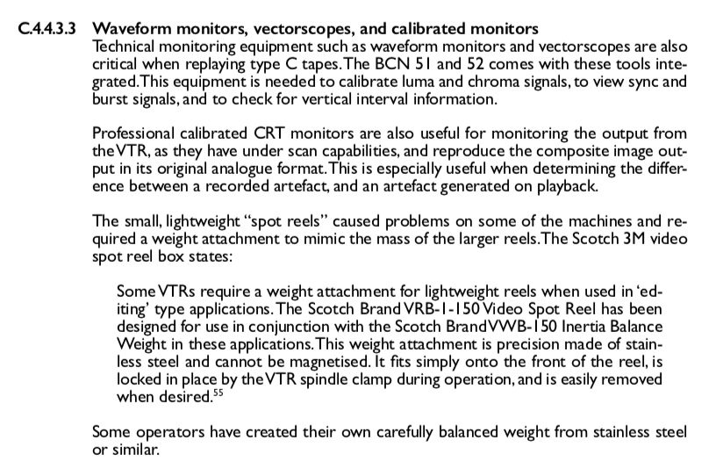
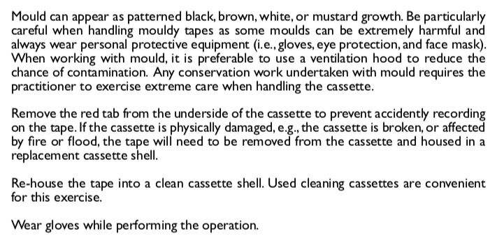
Selected notes from the text:
operating a 1-inch type C VTR
replacing capstan on a 1/2-inch open reel player
treating mould on U-matic cassettes
Notes:
For example, here are a few paragraphs that pertain to:
operating a one-inch type C VTR
replacing the capstan on a half-inch open reel player
and treating mould on U-matic cassettes.

Slide 39
Part D. Planning, Setup, and Workflows for Video digitisation
Notes:
Part D is a high-level description of the setup and operation of a digitisation facility.

Slide 40
Part D. Planning, Setup, and Workflows for Video digitisation
Introduction
Planning, preparing collection materials for digitisation
Setting up and testing a digitising facility and system
Operating a digitising facility and system
Notes:
The information in Part D is intended to support an archive planning or operating a facility of their own.
This section is the work of Andy Martin from the service provider DAMsmart in Canberra, Australia.

Slide 41
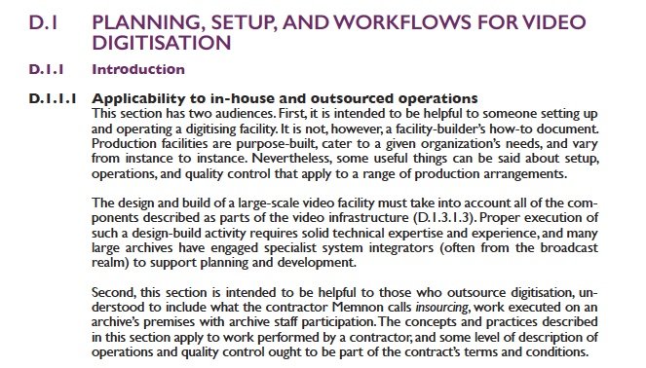
The concepts and practices described in this section also apply to work performed by a contractor, and some level of description of operations and quality control ought to be part of the contract’s terms and conditions.
Notes:
This information is equally important if you outsource work, to help you know what to look for in a proposal from a prospective contractor. For any operation, you need to know what to monitor as work proceeds.

Slide 42
Video production tech infrastructure
VTRs and intimate supporting elements
Other components that support VTRs
Playback and signal monitoring tools
Cabling, connectors, patch panels
Patch Panels
Support for multi-stream & robotic transfer
Electrical power
Environmental factors (air quality, temperature, humidity)
Environmental safeguards (smoke detectors, other detectors)
Availability of compressed air
Digitisation systems
IT infrastructure
Digitisation and IT system safeguards
Interim storage system "in the conversion lab"
Long-term storage and data management
Technical library
Service personnel, staff and on-call
Notes:
Let me highlight two segments of part D.
First: recommendations for the technical infrastructure components for a video production facility. Here's the list of 17 main headings

Slide 43
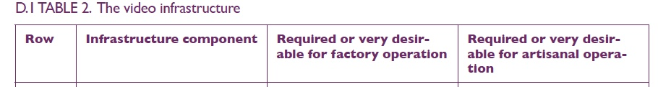
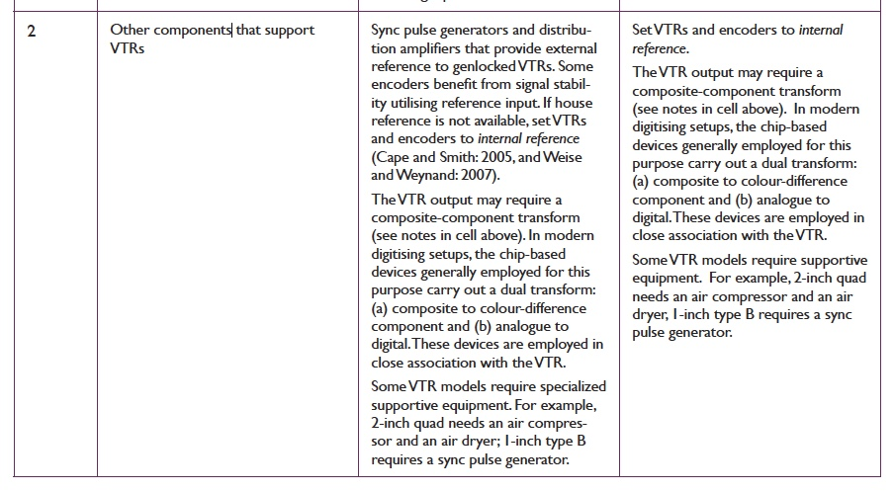
Notes:
These are introduced in a table with short explanations for both "factory" and "artisanal" operations. This row covers some of the gear needed to do a good job when playing back old tapes.

Slide 44
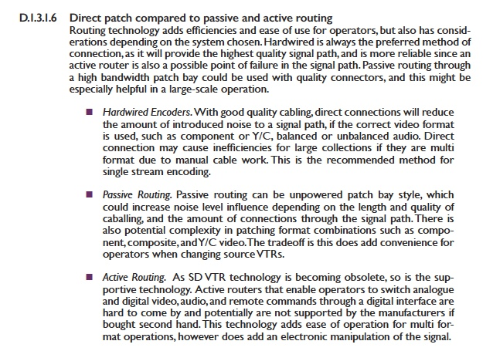
Notes:
More detailed explanations follow. Here's one pertaining to cabling and patch systems used to connect components.

Slide 45
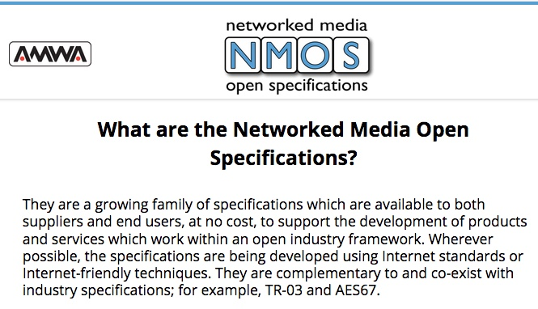
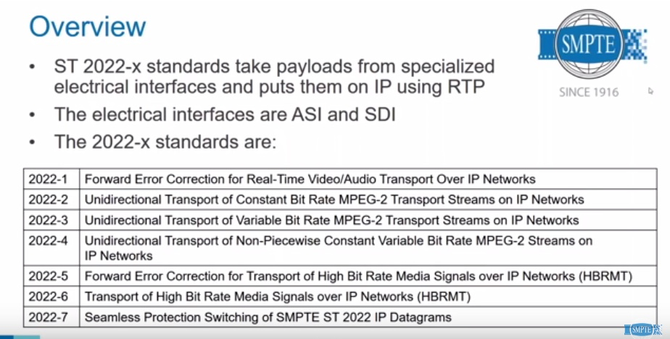


Notes:
Worth saying: TC 06 is written in terms of traditional video cabling and interfaces, as if they were permanent. In fact -- as the frame grabs on this slide prove -- the industry is in the midst of a "networking revolution," continuing the move from tape-based to file-based video recording. Tomorrow's video infrastructure will be built on information technology, and this section of TC 06 will need a rewrite.

Slide 46


Notes:
The second topic of special interest is a discussion of quality control (QC). This begins with a high-level commentary, and subsequently - - -

Slide 47
Types of automated QC tools
Open source applications, with no cost licenses
Applications from non-profit organizations, fee for license
Commercial applications
Commercial applications with integrated open source tools
Notes:
- - discusses automated tools to support QC. There is a lot of variation here: some are free, some are commercial - -

Slide 48
Types of automated QC tools
Open source applications, with no cost licenses
Applications from non-profit organizations, fee for license
Commercial applications
Commercial applications with integrated open source tools
Applications independent of specific hardware or systems
Applications integrated with hardware and/or other systems
Applications that depend upon specific hardware or systems
Notes:
- - some depend on the use of specific systems, some do not - -

Slide 49
Types of automated QC tools
Open source applications, with no cost licenses
Applications from non-profit organizations, fee for license
Commercial applications
Commercial applications with integrated open source tools
Applications independent of specific hardware or systems
Applications integrated with hardware and/or other systems
Applications that depend upon specific hardware or systems
Applications that inspect finished files and generate reports
Applications that inspect finished files, generate reports, and correct errors
Applications that monitor signal and/or bitstreams as playback and transfer proceeds
Notes:
- - some only look at finished files, some monitor work in progress as well as finished files. And some inspect a few things, some inspect many.
There is more information in the guideline, but the IASA Technical Committee is not an independent testing lab and we do not recommend specific products.

Slide 50
QC applications developed to support archives digitising video for content preservation
Association of Moving Image Archivists (AMIA): vrecord
Cube-Tec: Quadriga Video
Cube-Tec: MXF Legalizer
Dance Heritage Coalition and the Bay Area Video Coalition (BAVC): QCTools
GrayMeta: Iris (multiple versions)
Joanneum Research: VidiCert Essence QC
Matroska.org: mkvalidator
MediaArea: MediaConch
NOA: FrameLector, Video Migration QC, and QualityChecker
Notes:
We listed the QC tools we were able to identify. Several are products specifically developed to support preservation.

Slide 51
QC applications developed to support professional production, broadcast, and online content
Drastic Technologies: videoQC suite
Interra Systems: Baton Media Player, Baton Content Corrector
Metaglue: MXFixer
Mividi Inc: IMS120 Multiviewer Monitor
Quales.tv: Video Quality Check system
Tektronix: Aurora, successor to the Cerify QC tool, AutoFix correction tools
Telestream: Vidchecker
Venera Technologies: Pulsar and Quasar
Notes:
Several other tools were developed to support ongoing production, usually in a professional context, but these can also be effectively used to support preservation.

Slide 52
IASA-TC 06 Authors and Contributors
George Blood (George Blood LP, Philadelphia)
John Bostwick (George Blood LP)
Kevin Bradley (National Library of Australia), general editor
Charles Churchman (C.W. Churchman Television, Pennsylvania)
Carl Fleischhauer (Library of Congress, retired), general editor
Ross Garrett (NFSA, Australia)
Lars Gaustad (National Library of Norway and Chair IASA TC)
Dinah Handel (Stanford University)
Andrew Martin (DAMsmart, Canberra)
Andrew Pearson (British Library)
James Snyder (Library of Congress)
Tom Sprague (Museum of Broadcast Technology)
Notes:
OK -- that is enough for today! I hope this gives you a sense of what IASA-TC 06 covers.
I named a few contributors already: here is the complete list. The IASA TC offers its heartfelt thanks to these many volunteers!

Slide 53
https://www.iasa-web.org/tc06/
guidelines-preservation-video-recordings
An improved version of TC 06 is planned. Help us fill in omissions and correct errors.
Send comments to Lars Gaustad (lars.gaustad@nb.no)
Thank you
Notes:
We want to improve this first edition of TC 06. Please send us a note to help us fill in omissions and correct errors. Send comments to the chair of the IASA Technical Committee: Lars Gaustad (lars.gaustad@nb.no).
Thank you for your interest.

